Slide 1
Visiting London City
Capstone Project – The Battle of Neighborhoods
Jorge Álvarez de la Fuente

Slide 2
Business Problem
London is a world tourist destination with full potential to become the best city to visit in Europe but it still has challenges for visitors.
This project will analyse the venues available for people visiting London in order to look for the best recreational activities and locations in the variety of districts in London city.
This project is interesting to visitors and expats who are considering visiting and relocating to London as they will be able to identify the most attractive locations and venues there.

Slide 3
Data Acquisition and Sources
Data Acquired
Sources
Postal Code
District
Postal Code Latitude
Postal Code Longitude
Venue
Venue Latitude
Venue Longitude
Venue Category
Most common venue
Milesfaster website
ArcGIS
Foursquare API

Slide 4
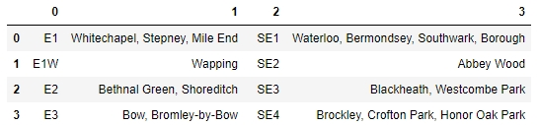
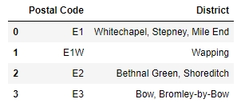
Data Cleaning
Scraping process of postal codes with their respective districts using Milesfaster website:
Results after the data cleaning process:

Slide 5
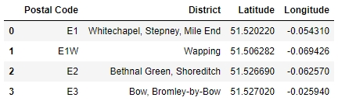
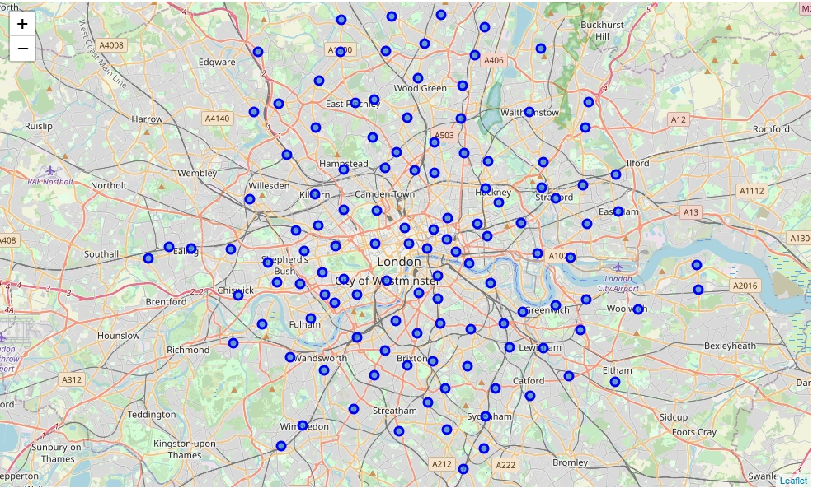
ArcGIS and Foursquare API
ArcGIS was used to get the coordinates for all districts:
Foursquare API was used to explore the districts and segment them. The map of London city was visualized:

Slide 6
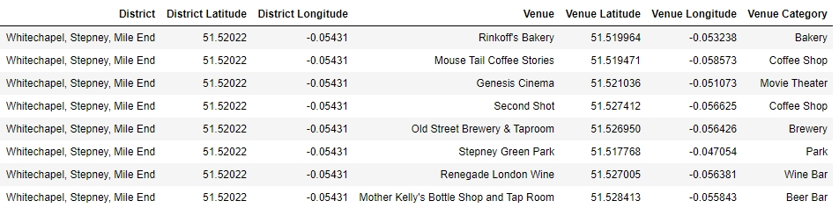
Foursquare API
The function getNearbyVenues obtains information per venue and contains the API request url, the GET request. A DataFrame was created with new columns: district, district latitude, district longitude, venue name, venue latitude, venue longitude and venue category.
The function getNearbyVenues retrieved a total of 11,145 venues.

Slide 7
Methodology
Foursquare API was used to explore all venues of all districts and analyse each district in London.
The most relevant venues to visit were retrieved from the entire DataFrame and visualized.
The most common venues were analysed using word cloud to look for the most common words and translate them into venues.
Each district was grouped with the 10 most common venues.
All districts in London city were clustered, visualized and examined using k-means algorithm.
The resulting clusters were analysed using word cloud to validate the previous analyses.

Slide 8
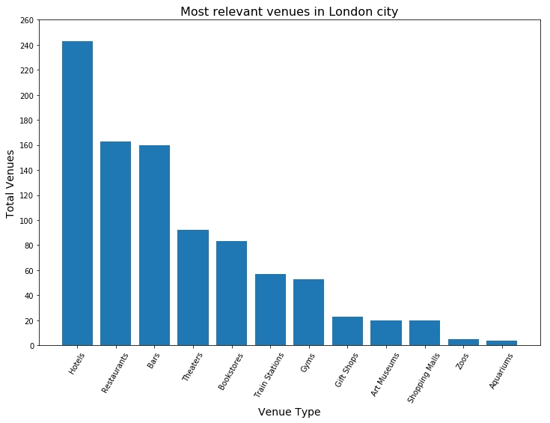
Explanatory Analysis. Analyzing districts
This section consists in performing an explanatory data analysis and deriving some additional information.
A new DataFrame containing random chosen relevant venue categories was created to evaluate whether or not London is a good place to visit.
The visualizations were developed using bar plots as follow.

Slide 9
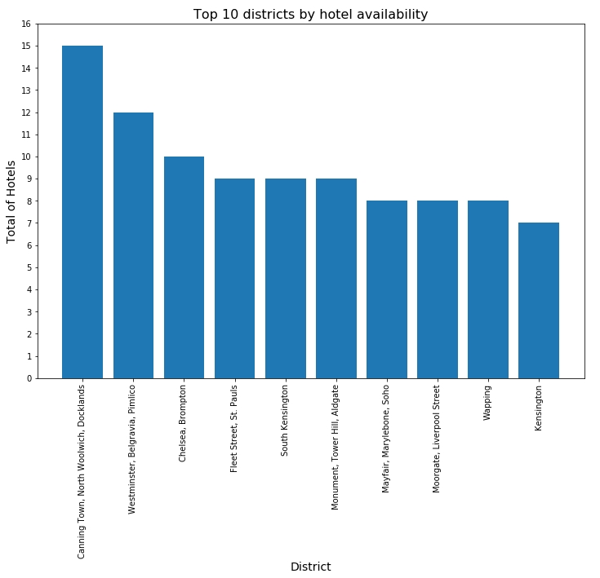
Explanatory Analysis. Analyzing districts
From the venues randomly selected, hotels are the most common venue in London city, followed by restaurants. Hotels were grouped by district to find the top 10 districts that have more hotels in London city.

Slide 10
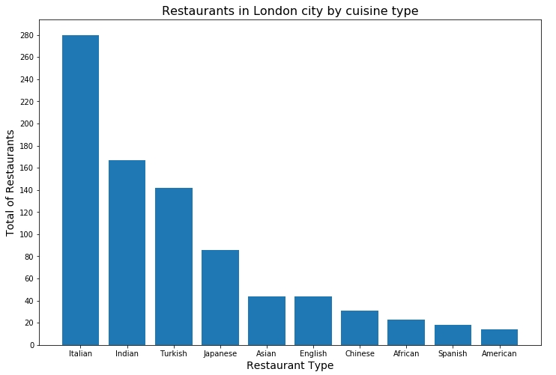
Explanatory Analysis. Analyzing districts
Restaurants is the second most popular venue from the random categories selected.

Slide 11
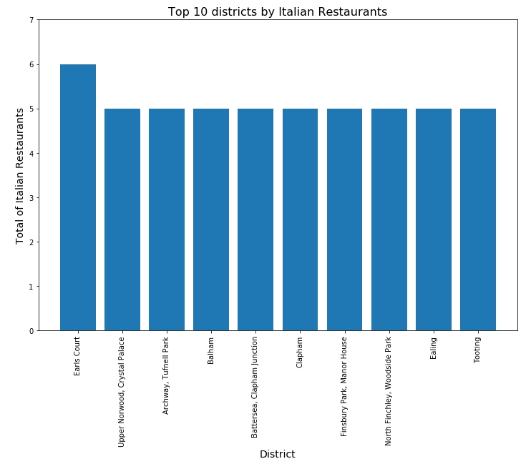
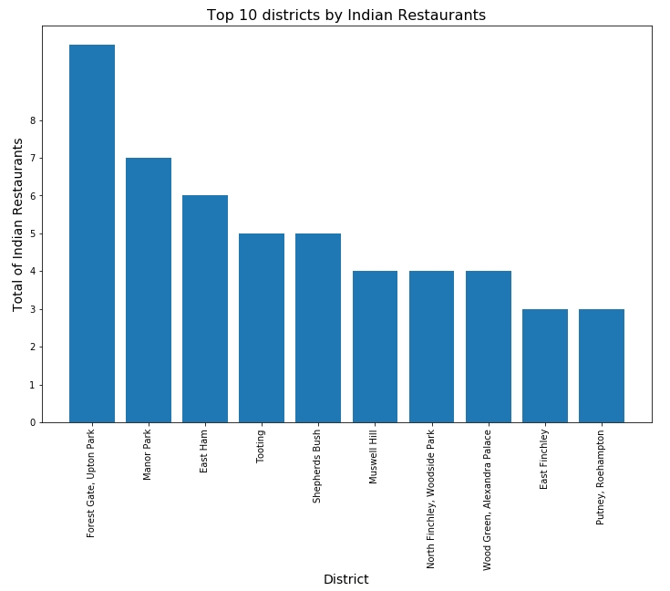
Explanatory Analysis. Analyzing districts

Slide 12
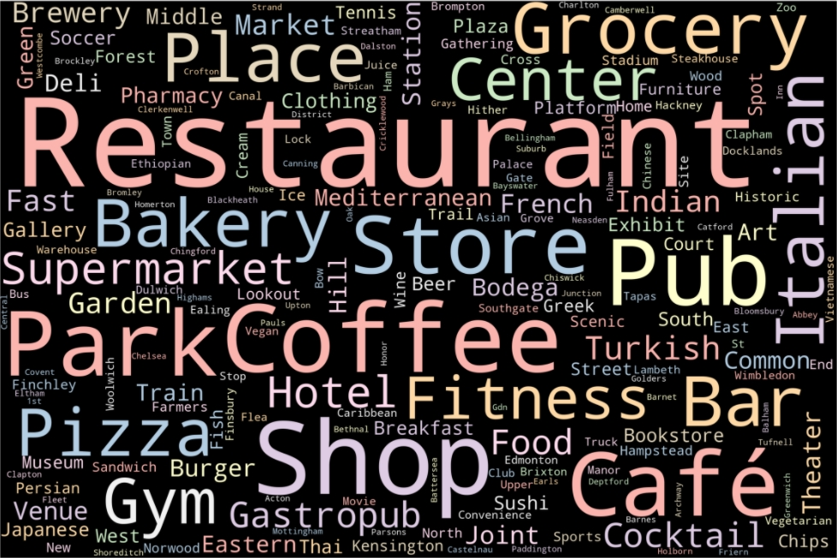
Explanatory Analysis. Analyzing districts
Word clouds visualization was applied to find the most common venues in London city.

Slide 13
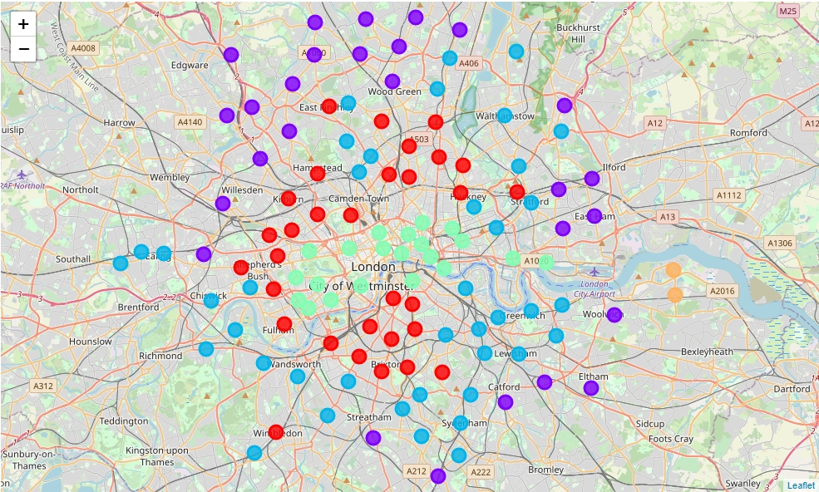
Explanatory Analysis. Clustering districts
London city map with all clusters represented with different colors
Map legend:
Cluster 0: Red
Cluster 1: Purple
Cluster 2: Light Blue
Cluster 3: Light Green
Cluster 4: Light Orange

Slide 14
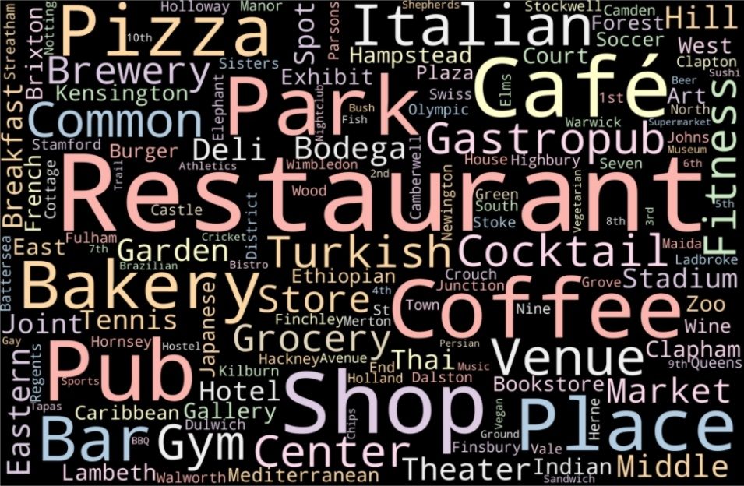
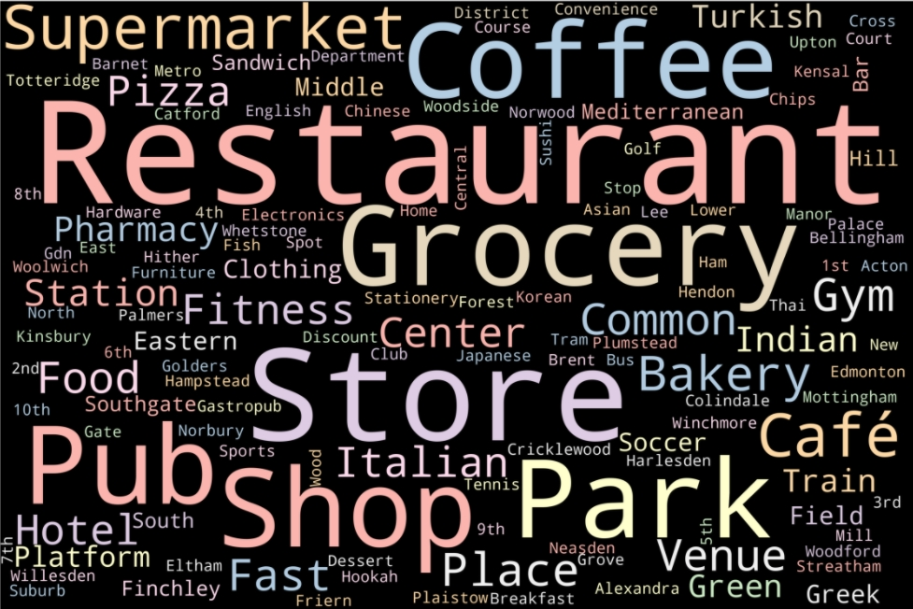
Explanatory Analysis. Examining districts
Cluster 0 Word Cloud
Cluster 1 Word Cloud

Slide 15
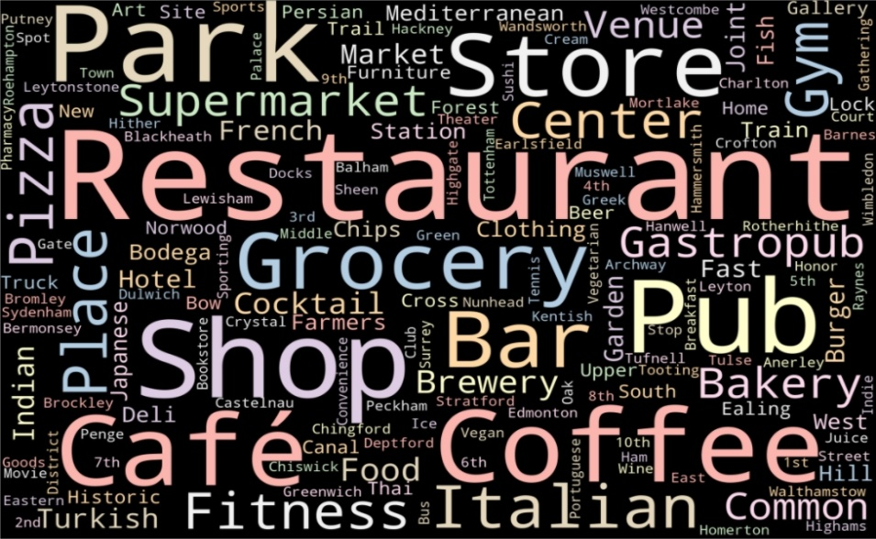
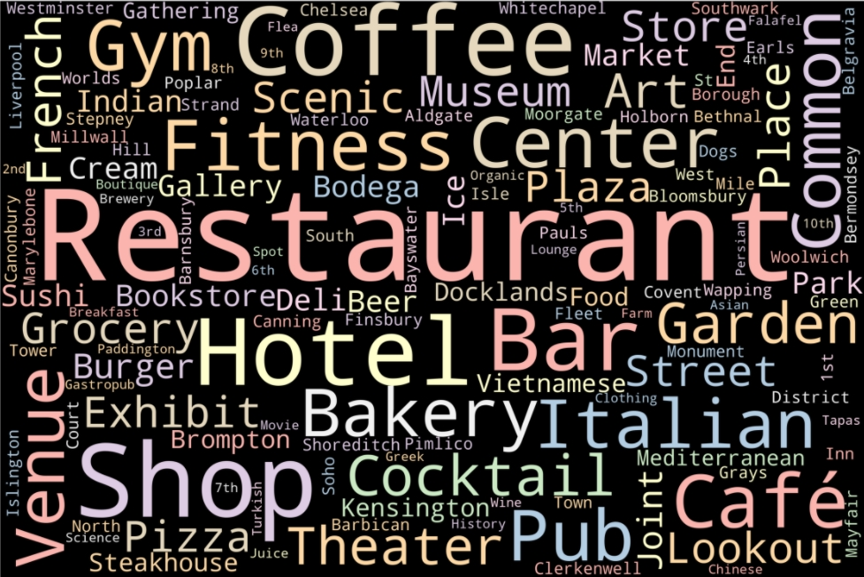
Explanatory Analysis. Examining districts
Cluster 2 Word Cloud
Cluster 3 Word Cloud

Slide 16
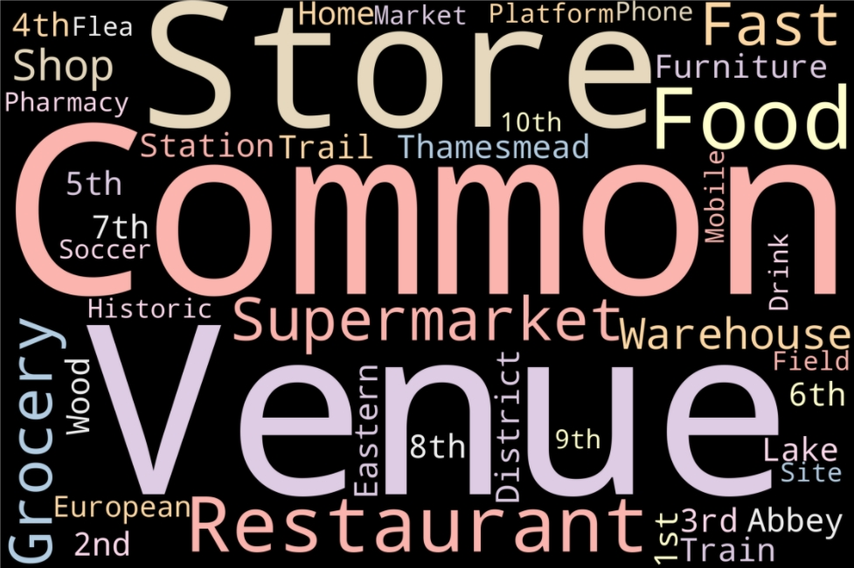
Explanatory Analysis. Examining districts
Cluster 4 Word Cloud

Slide 17
Conclusions
From the visitors perspective, the most relevant venues found in the explanatory analysis were hotels, restaurants, bars, theaters, pubs, bakeries, groceries, coffee shops, gyms.
The most popular cuisine types were italian food, indian food, turkish food and japanese food.
Most hotels were found in districts located in southwest and north of London city, while most restaurants were found in districts located in east and northeast of London city.
It was found that most of the venues revealed during the explanatory analysis are located in London center, center-east, south and north periphery too.

Slide 18
Limitations
There are a number of gaps in the present project that could be benefitted from further research.
The explanatory analysis results depend on the accuracy of Foursquare data and the Milesfaster website has limitations as per the number of postal codes included.
A more detailed evaluation should have included prices and iconic attractions in London city such as Buckingham Palace and Big Ben.

